Slide 1
CO1-AT2- TECHNICAL PRESENTATION
Importance of SDLC in E-Commerce Development
Names: Durga Sree R
Register Number: 192411189
Course Code & Name: CSA1104 – Object Oriented Analysis And Design
Faculty: Dr.A.Gayathri

Slide 2



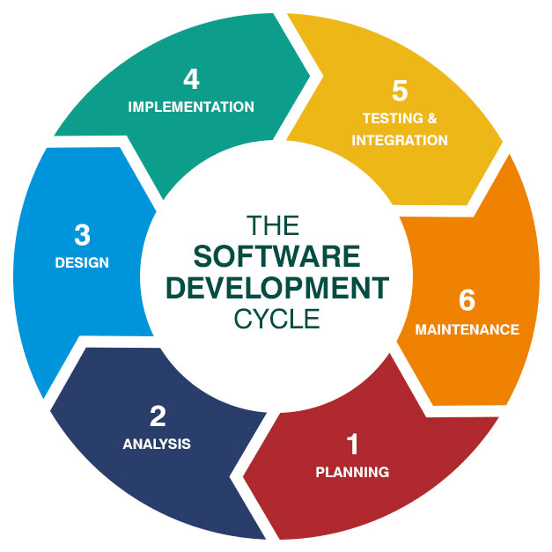
Importance of SDLC in
E-Commerce Development
SDLC is a systematic process for developing software.
E-commerce systems manage products, payments, and orders.
SDLC helps organise the development process effectively.
It ensures software quality, reliability, and security.
It improves customer satisfaction and user experience.

Slide 3
Planning and Requirement Analysis
Planning identifies project goals, resources, cost, and schedule.
Requirement Analysis identifies customer and business needs.
Requirements include products, cart, payment, and order tracking.
Proper planning reduces development risks and errors.
Clear requirements ensure the right features are developed.

Slide 4
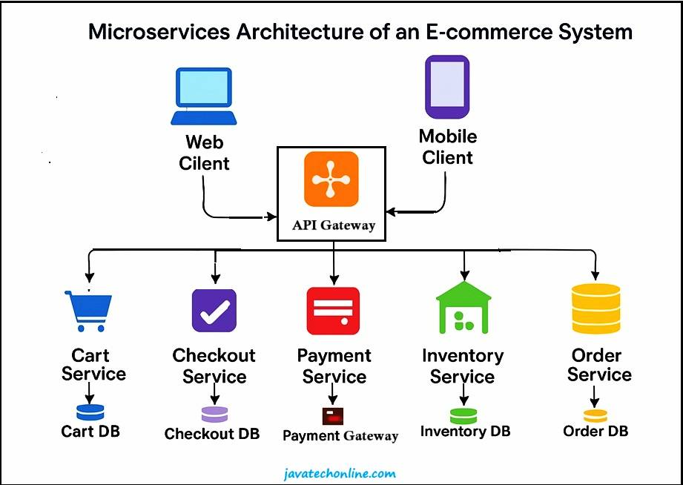
System Design and Development
Design defines the system architecture, database, and user interface.
A modular design makes the system easy to understand.
Development converts the design into working software.
Developers implement products, payments, and order management.
Good design and coding improve maintainability and scalability.

Slide 5
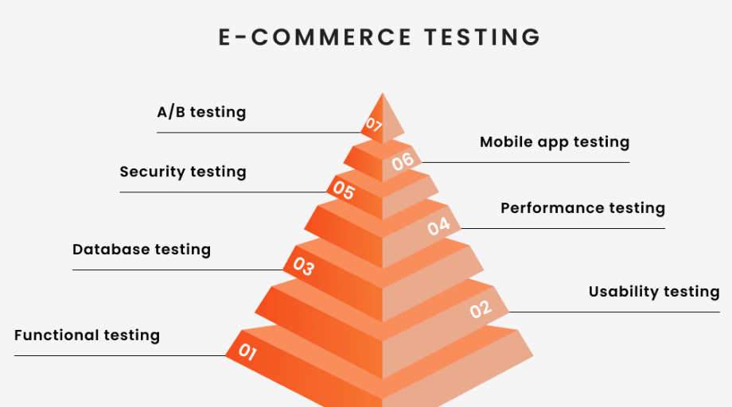
Testing and Deployment
Testing identifies bugs, errors, and security vulnerabilities.
Payment, login, ordering, and tracking features are tested.
Testing improves software quality and reliability.
Deployment makes the completed application available to users.
Proper deployment provides a smooth and secure shopping experience.

Slide 6
Maintenance and Conclusion
Maintenance fixes bugs and improves existing features.
New features can be added based on customer requirements.
SDLC improves quality, reliability, security, and performance.
A reliable system increases customer trust and satisfaction.
Therefore, SDLC is essential for successful e-commerce development.

Slide 7
Thank you

